Slide 1

Data Analysis
Financial Benchmarking and Performance Analysis of Fortune 500 Companies in India
Financial Snapshot & Strategic Insights (Web-scraped dataset)

Slide 2
Problem Statement
While the Fortune 500 list highlights the top-performing companies in India, it does not automatically reveal:
Which companies are most financially stable considering profits, debt, and assets?
The relationship between workforce size and company profitability.
Which sectors drive India’s economic growth and how performance varies across them.
Objectives & Methodology
Presentation Goal: To analyze the financial health, sectorial leadership, and future drivers of the top 500 Indian corporations.
Data Source: Fortune India 500 (2024 Ranking)
Methodology: Deep-dive Web Scraping and Financial Modeling (briefly mention the Jupyter Notebook process).

Slide 3

Import essential libraries
BeautifulSoup
NumPy
Pandas
Pandas
Matplotlib
Seaborn

Slide 4

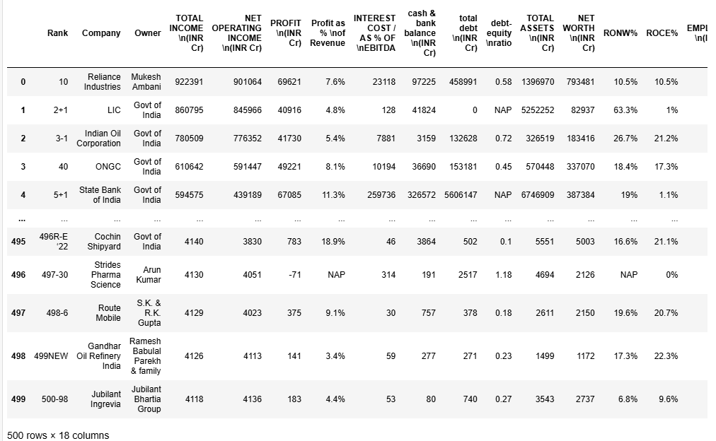
Scraping Data From website
Total number of entries collect from webiste: 500

Slide 5
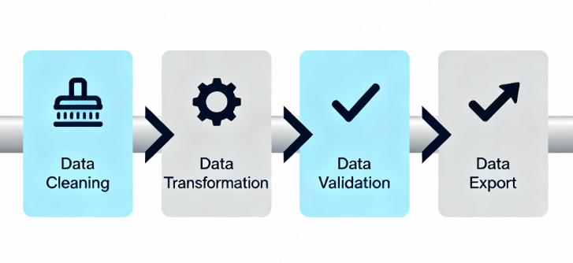
Data Wrangling Process — From Raw to Refined Data

Slide 6
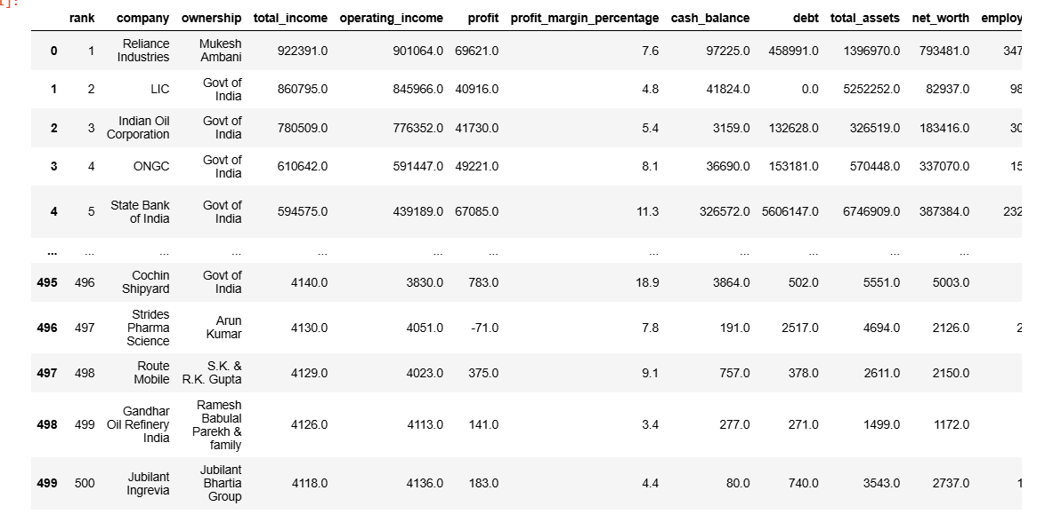

After Data Wrangling Process

Slide 7

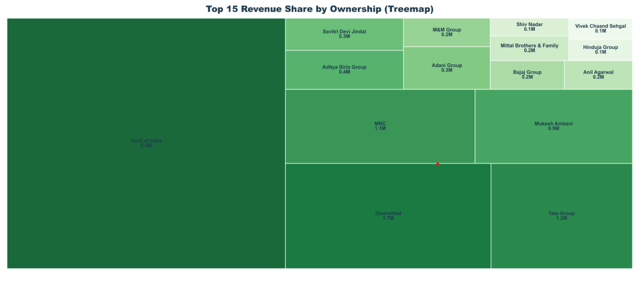
Top 15 Revenue Share by Ownership (Treemap)
🏛️ Public Sector Dominance: Govt of India leads with 44.5% of total revenue.
💼 Other Key Players: Ambani, Aditya Birla & Jindal groups contribute ~12% combined.

Slide 8
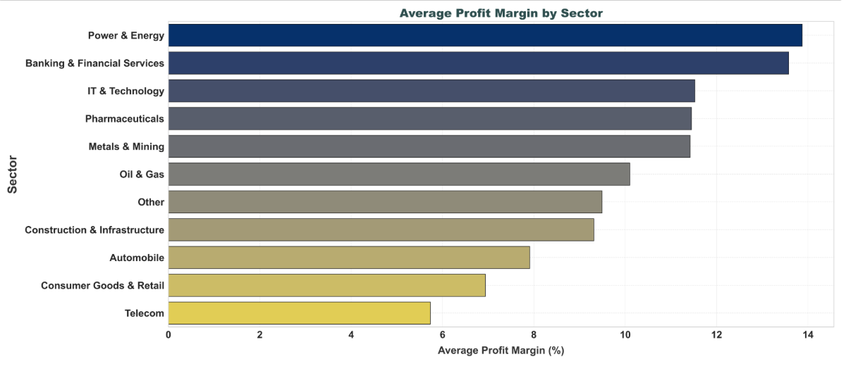
Average Profit Margin by Sector
⚡ Top Sector: Power & Energy leads with the highest avg. profit margin.
📉 Lagging Sector: Telecom posts the lowest margin, showing financial stress.
📊 Benchmark: Overall avg. profit margin = 10.12%; Banking, IT & Pharma exceed it.

Slide 9
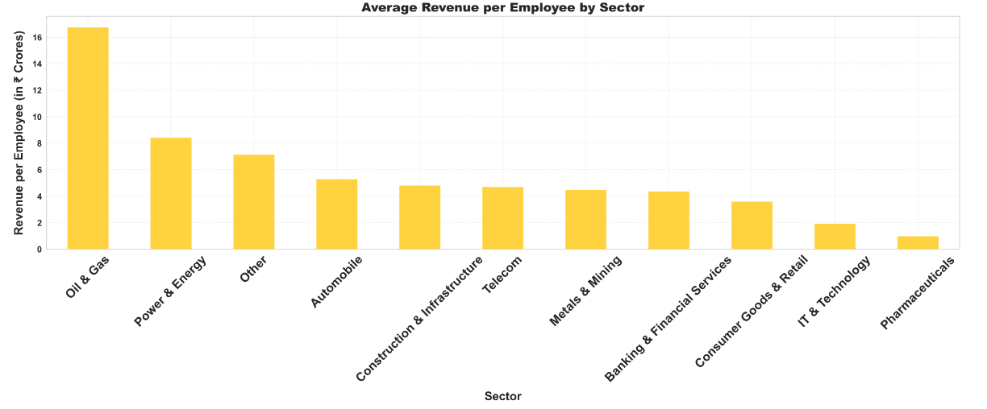
Average Revenue per Employee by Sector
💼 Top Performer: Oil & Gas leads with ₹16+ Cr per employee, showing high labor productivity.
📉 Lowest Performer: Pharmaceuticals record the lowest productivity, well below cross-sector average.
📊 Sector Average: Overall average is ₹5.68 Cr per employee.

Slide 10
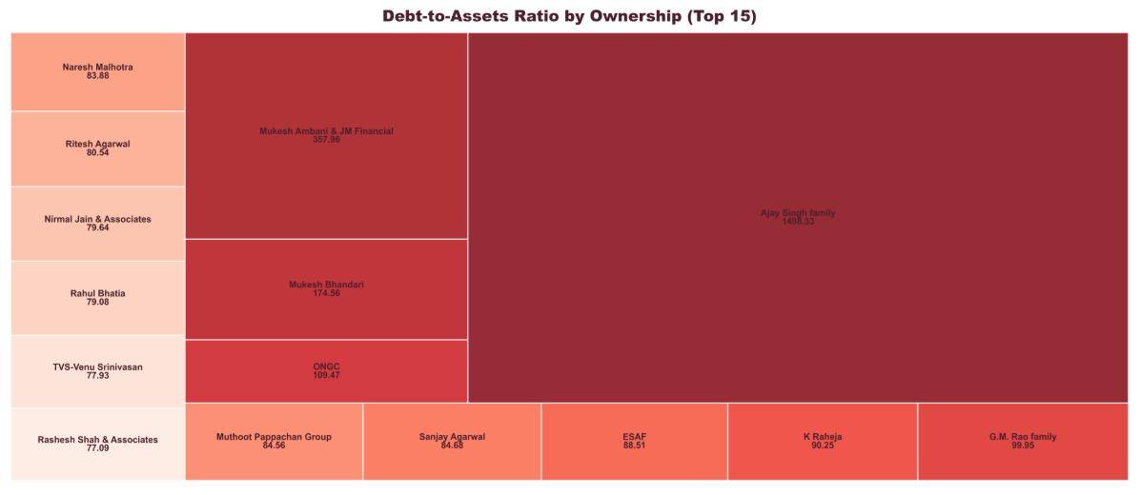
Debt-to-Assets Ratio by Ownership
⚠️ High Risk: Ajay Singh Family — 1409.33 (very high leverage)
✅ Low Risk: Rashesh Shah & Associates — 77.09 (conservative structure)
📊 Average: 204.43 across top 15 owners → overall high borrowing trend

Slide 11
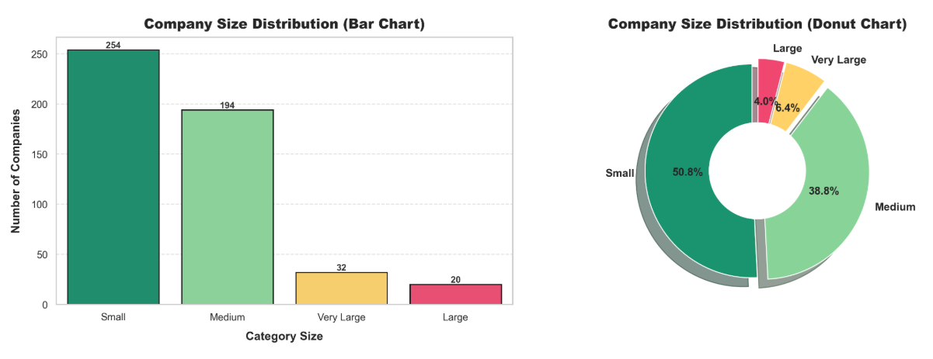
Company Size Distribution
🏢 Small Companies: Dominate the dataset — 50.8% (254 firms)
🏬 Medium Firms: Strong mid-tier segment — 38.8% (194 firms)
🏢🏢 Large & Very Large: Only 10.4% (52 firms)

Slide 12
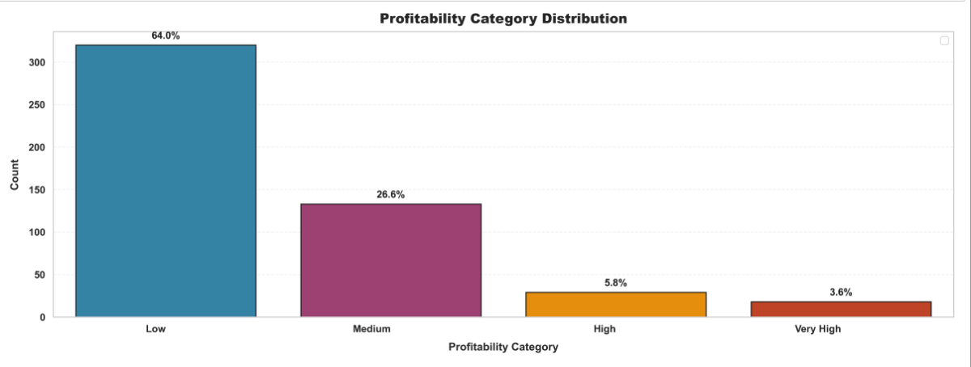
Profitability Category Distribution
Here’s your text with emojis added for a PPT-friendly look:
📉 64% Low Performers: Most companies show weak profitability.
🌟 Only 9.4% High Performers: Very few industry leaders.
🏭 Overall Health: Industry performance needs improvement.

Slide 13
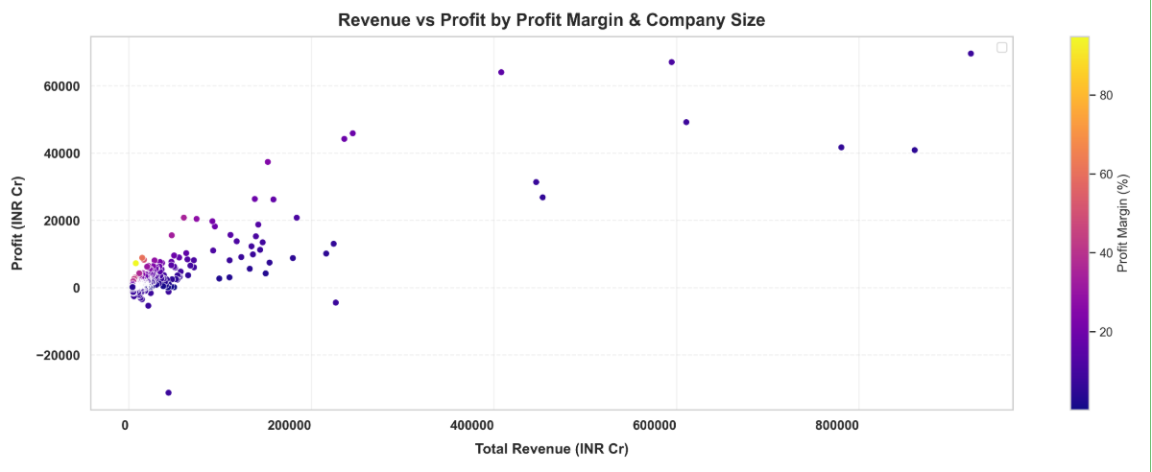
Revenue vs Profit by Profit Margin & Company Size
🏆 Top Performer: Reliance Industries leads in Revenue ₹922,391 Cr & Profit ₹69,621 Cr.
📉 Lowest Performers: Jubilant Ingrevia has lowest revenue ₹4,118 Cr; Vodafone Idea reports largest loss ₹–31,238 Cr.
💰 Profitability: Average profit margin = 10.32%, indicating moderate profitability.

Slide 14
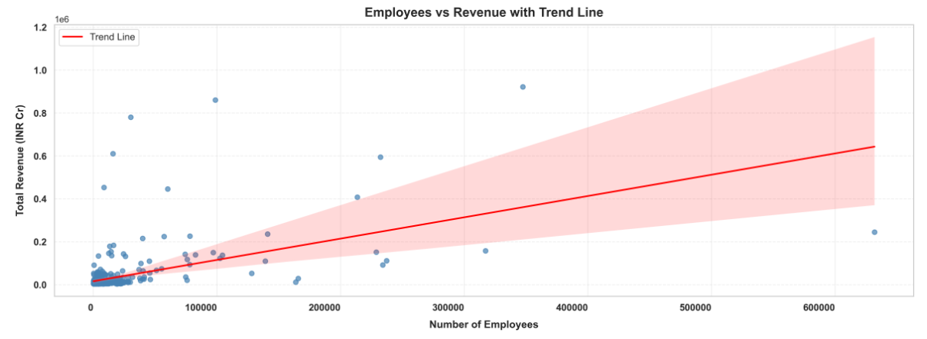
Employees vs Revenue with Trend Line
📈 Positive Correlation (0.51) – Larger firms tend to earn higher revenues.
🏆 Top Performer: Reliance Industries — ₹922,391 Cr revenue, 3.47L employees.
⚡ Most Efficient: Petronet LNG — ₹196.82 Cr per employee.
🐢 Least Efficient: SIS — ₹0.08 Cr per employee.

Slide 15
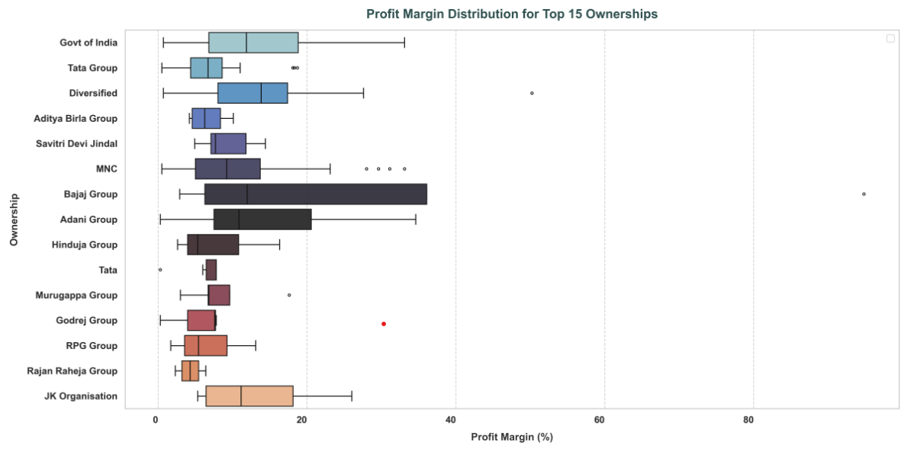
Profit Margin Distribution for Ownerships
Leaders: Bajaj Group – 🏆 highest median profit margins
Stable: Govt of India, Tata, Aditya Birla – ⚖️ consistent, moderate margins
Variable: MNCs & diversified groups – 🎢 some outliers, most lower

Slide 16
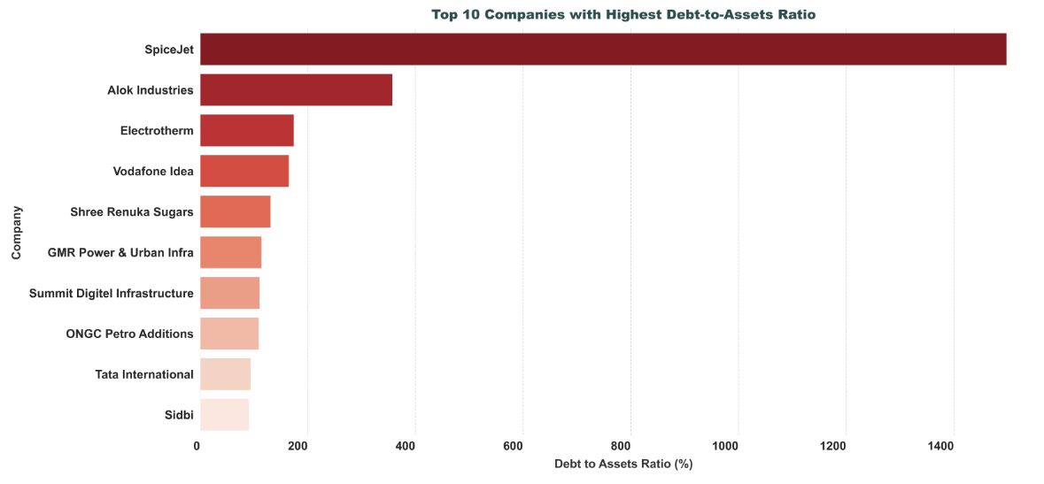
Top 10 Companies with Highest Debt-to-Assets Ratio
SpiceJet: Outlier with very high debt → heavy reliance on debt 💸
Alok Industries: High leverage, 2nd only to SpiceJet ⚡
Sectors Affected: Manufacturing, Telecom, Infrastructure, Financial Services 🏭📡🏗️💰

Slide 17
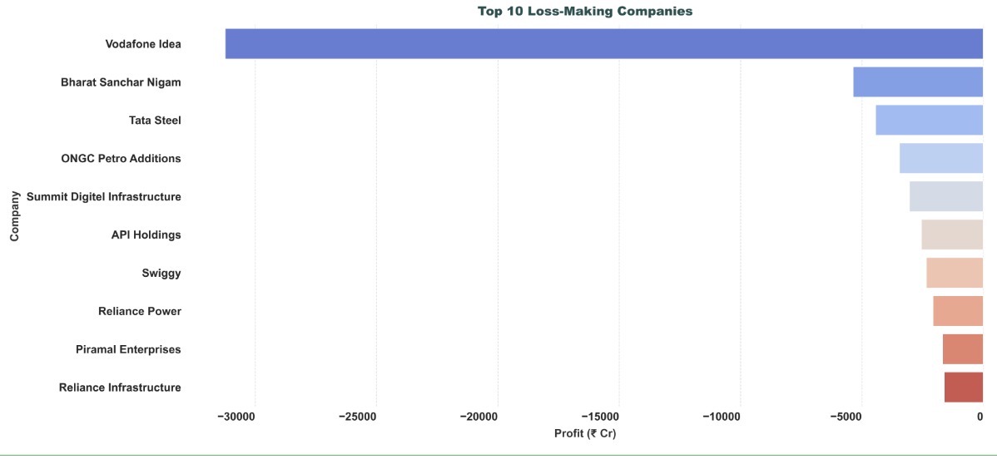
Top 10 Loss-Making Companies
📉 Major Outlier: Vodafone Idea suffers extreme losses.
🏛️ Public Sector Woes: BSNL faces heavy financial strain.
🌐 Across Industries: Losses seen in legacy, infra & new-age sectors.
⚠️ Persistent Risk: Structural & market challenges threaten sustainability.

Slide 18

📊 Key Financial Insights & Observations
🏆 Top Performers
Revenue: Reliance ₹9.22L Cr, LIC ₹8.61L Cr, IOC ₹7.81L Cr
Profit: Reliance ₹69,621 Cr, SBI ₹67,085 Cr, HDFC ₹64,062 Cr
Margins: Bajaj 94.8%, Rattanindia 60.6%, NSE 50.2%
💹 Financial Health
Debt Avg 7.6%, 14 zero-debt companies
ROA Avg 21.3%, Net worth ↔ Profit 0.87
Revenue/Employee ₹6.37 Cr, Profit/Employee ₹0.55 Cr
🏛️ Govt vs 💼 Private
Govt 12.4% F500: energy, banking, insurance
Private 87.6%: diverse, innovative, higher margins
Govt: stable; Private: higher volatility, better efficiency
🌐 Sector Insights
Banking & Financial Services 💰 dominate
IT & Tech 🌍 strong global margins
Oil & Gas ⛽ high revenue, variable margins
Manufacturing 🏭 mixed performance

Slide 19
conclusion
The analysis highlights that family-owned businesses and MNCs demonstrate strong resilience and operational excellence , while government enterprises maintain strategic control over key sectors 🏛️. The primary drivers of success across the Fortune 500 companies include efficiency, scale, and innovation, which enable sustained profitability and competitiveness.
However, several risks persist , including high debt levels in certain firms, margin pressures in competitive industries, and exposure to cyclical sector fluctuations.
For policymakers, a balanced approach is essential—supporting public sector stability while fostering private sector innovation, and encouraging prudent debt management and sector diversification.
From an investor’s perspective , IT and financial services remain attractive due to strong risk-adjusted returns, whereas energy companies offer scale but require careful monitoring of margins. Government enterprises provide stable growth with lower volatility.
For corporate leadership, emphasis should be placed on improving efficiency and employee productivity, while strategically leveraging sector-specific strengths and managing inherent risks effectively.
Looking ahead , India’s corporate ecosystem remains globally competitive, with promising growth opportunities driven by digital transformation, sustainable energy initiatives, and financial inclusion, ensuring a robust foundation for continued success.

Slide 20
thank you

